Slide 1
Download & Install the Oracle Virtual BOX
Step 1
https://www.virtualbox.org/wiki/Downloads
Step 2
Download CentOS 9 Stream OS
https://www.centos.org/download/
Create 3 VMs
Step 3
Demo in LAB
Step 4
Install the CentOS 9
Install & then Clone the VM
Step 5
Bind the Mac address on your WIFI router
Demo in LAB
Step 6
Login to these VMs through SSH
Demo in LAB

Slide 2
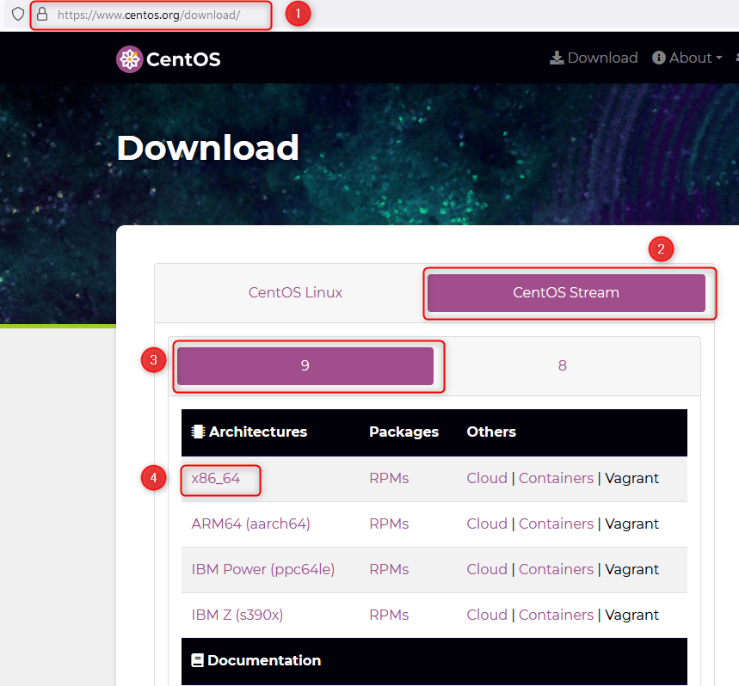
Download CentOS 9 Stream OS (Operating System)
Home

